Slide 1
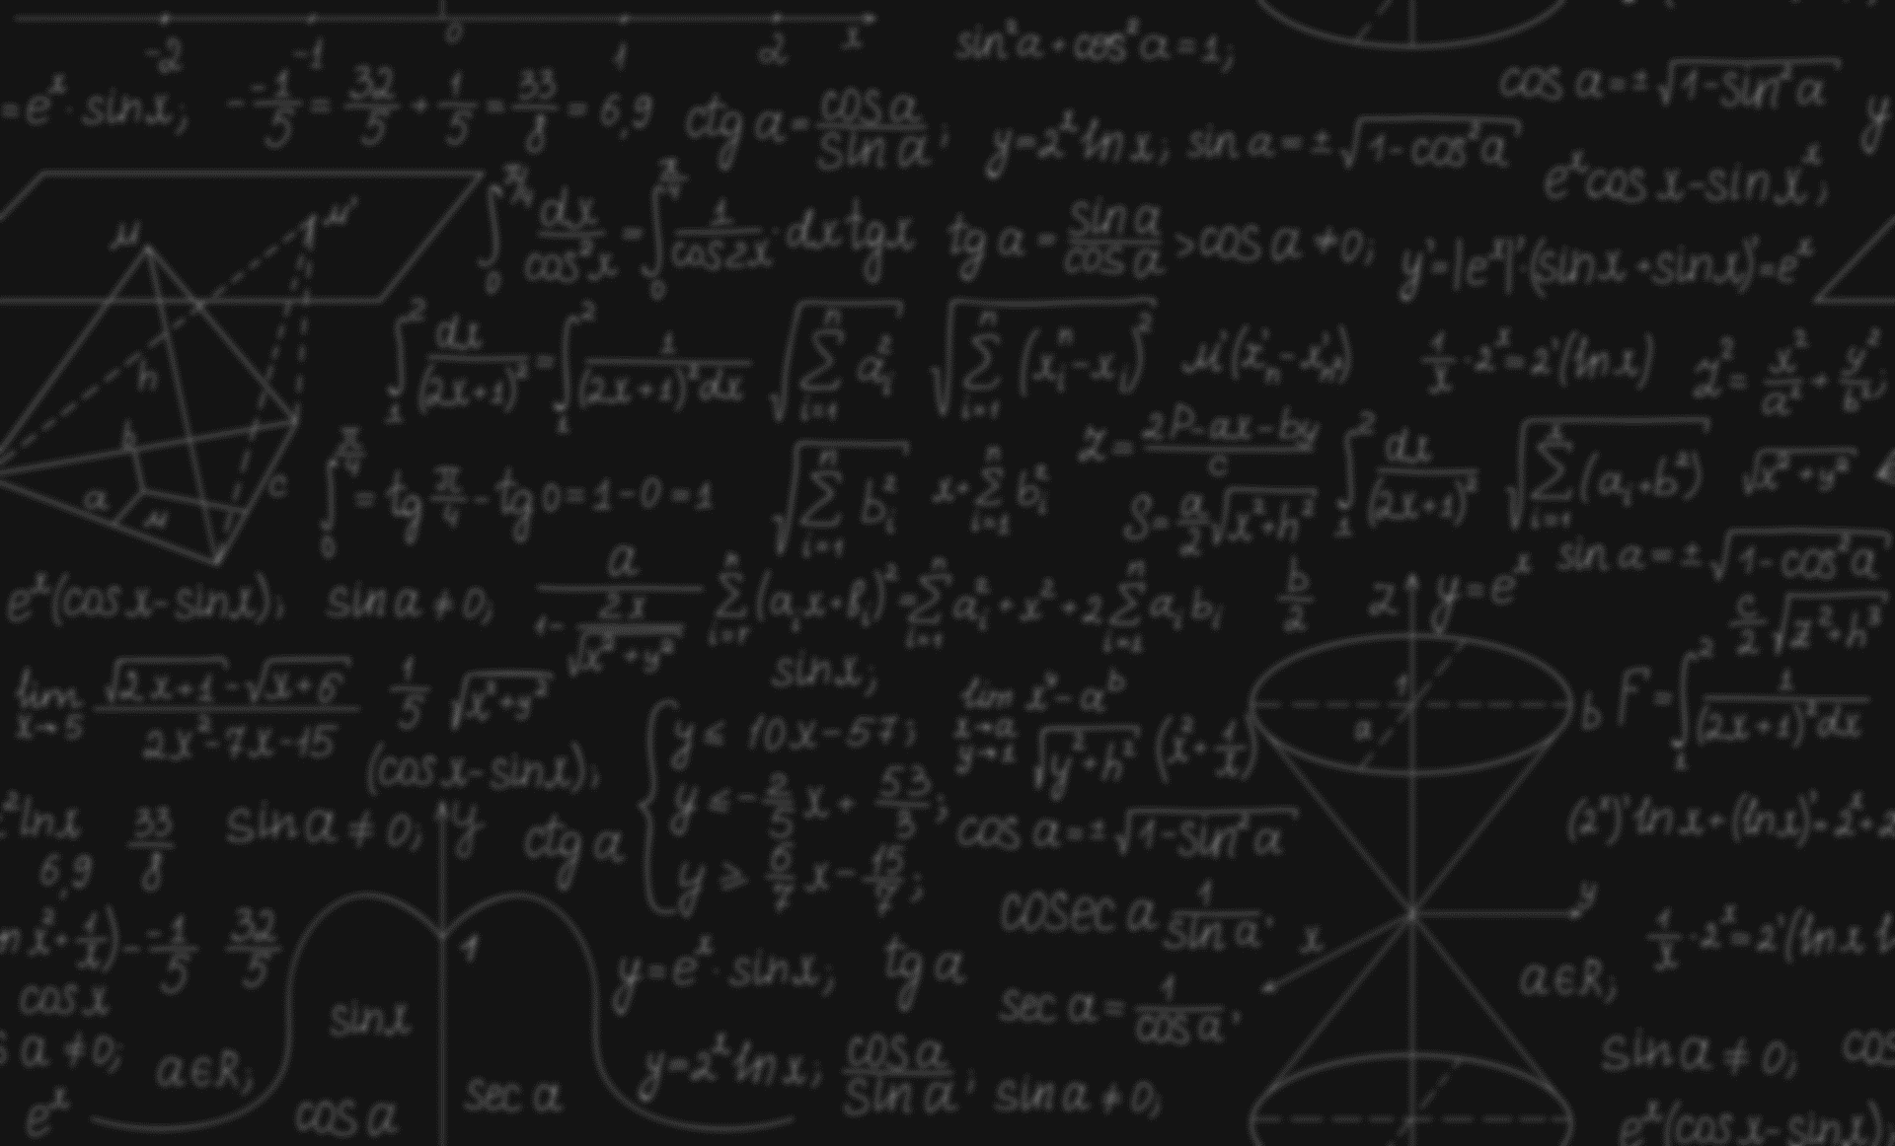

PHYSICS – HSC I ADMISSION
VECTOR
1
ZR Emon
HSC-22
MIST Dept. of ME
DU

